Slide 1
CSC D70: Compiler Optimization Prefetching
Prof. Gennady Pekhimenko
University of Toronto
Winter 2021
The content of this lecture is adapted from the lectures of
Todd Mowry and Phillip Gibbons

Slide 2
No Lecture on April 5th
I will be involved in MLSys 2021 conference

Slide 3
The Memory Latency Problem
↑ processor speed >> ↑ memory speed
caches are not a panacea

Slide 4
Prefetching for Arrays: Overview
Tolerating Memory Latency
Prefetching Compiler Algorithm and Results
Implications of These Results

Slide 5
Coping with Memory Latency
Reduce Latency:
Locality Optimizations
reorder iterations to improve cache reuse
Tolerate Latency:
Prefetching
move data close to the processor before it is needed

Slide 6
Tolerating Latency Through Prefetching
Without Prefetching
With Prefetching
Prefetch A
Time
Prefetch B
Fetch A
Fetch B
Load A
Load A
Load B
Fetch A
Load B
Fetch B
Executing Instructions
Stalled Waiting for Data
overlap memory accesses with computation and other accesses

Slide 7
Types of Prefetching
Cache Blocks:
(-) limited to unit-stride accesses
Nonblocking Loads:
(-) limited ability to move back before use
Hardware-Controlled Prefetching:
(-) limited to constant-strides and by branch prediction
(+) no instruction overhead
Software-Controlled Prefetching:
(-) software sophistication and overhead
(+) minimal hardware support and broader coverage

Slide 8
Prefetching Goals
Domain of Applicability
Performance Improvement
maximize benefit
minimize overhead

Slide 9
Prefetching Concepts
possible only if addresses can be determined ahead of time
coverage factor = fraction of misses that are prefetched
unnecessary if data is already in the cache
effective if data is in the cache when later referenced
Analysis: what to prefetch
maximize coverage factor
minimize unnecessary prefetches
Scheduling: when/how to schedule prefetches
maximize effectiveness
minimize overhead per prefetch

Slide 10
Reducing Prefetching Overhead
instructions to issue prefetches
extra demands on memory system
important to minimize unnecessary prefetches
Hit Rates for Array Accesses

Slide 11
Compiler Algorithm
Analysis: what to prefetch
Locality Analysis
Scheduling: when/how to issue prefetches
Loop Splitting
Software Pipelining

Slide 12
Steps in Locality Analysis
1. Find data reuse
if caches were infinitely large, we would be finished
2. Determine “localized iteration space”
set of inner loops where the data accessed by an iteration is expected to fit within the cache
3. Find data locality:
reuse ∩ localized iteration space ⇒ locality

Slide 13
Data Locality Example
for i = 0 to 2
for j = 0 to 100
A[i][j] = B[j][0] + B[j+1][0];
Hit
Miss
A[i][j]
B[j+1][0]
B[j][0]
i
i
i
j
j
j
Spatial
Temporal
Group

Slide 14
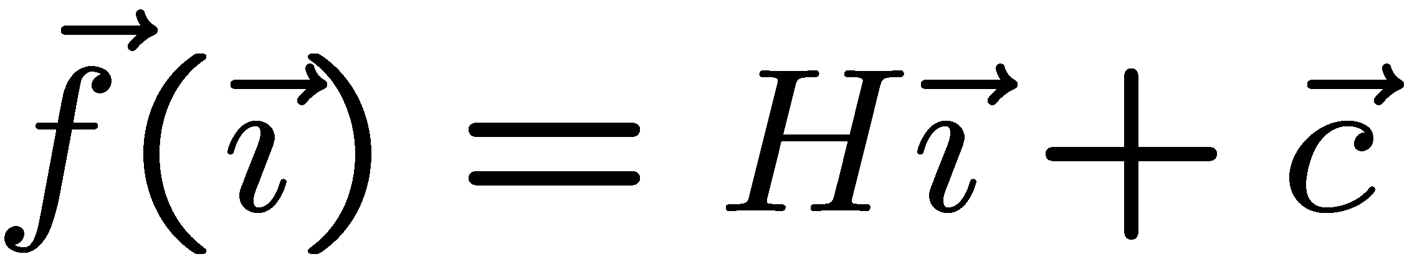
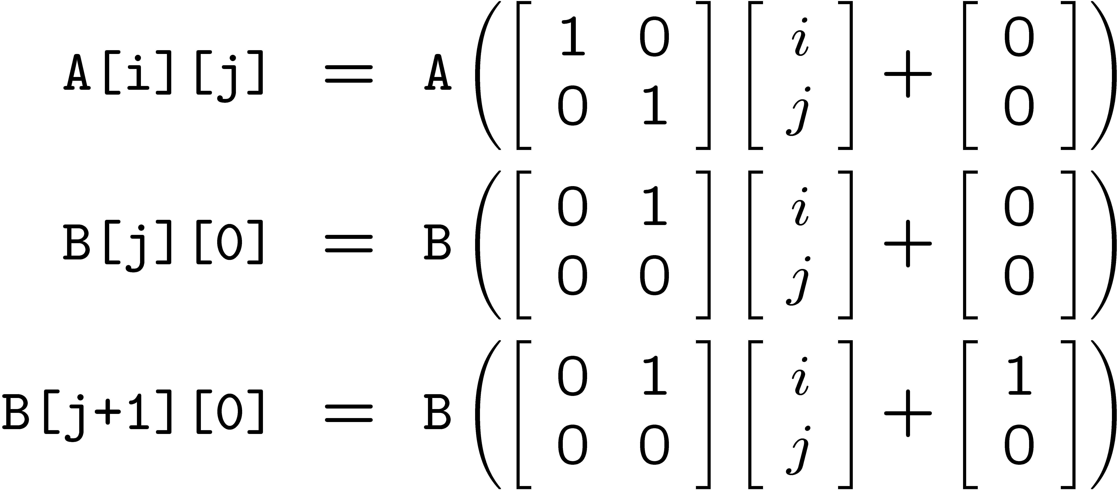
Reuse Analysis: Representation
for i = 0 to 2
for j = 0 to 100
A[i][j] = B[j][0] + B[j+1][0];
Map n loop indices into d array indices via array indexing function:

Slide 15
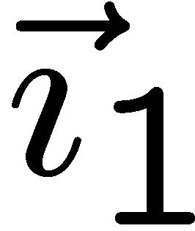
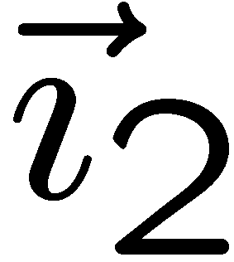
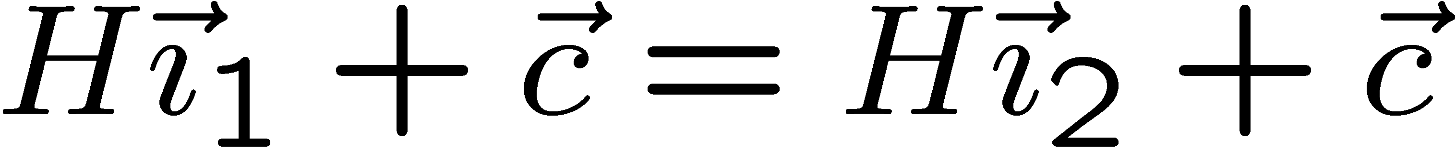
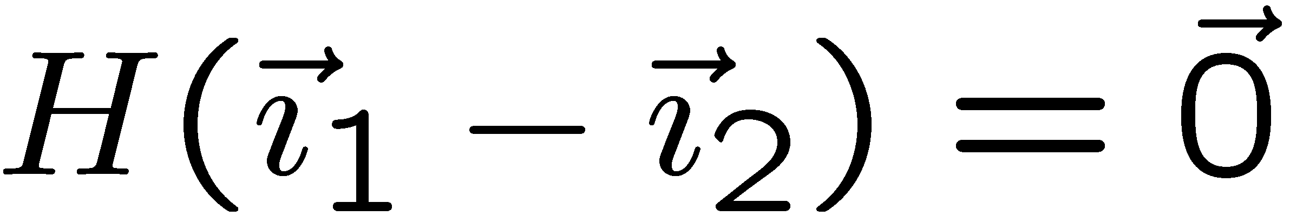

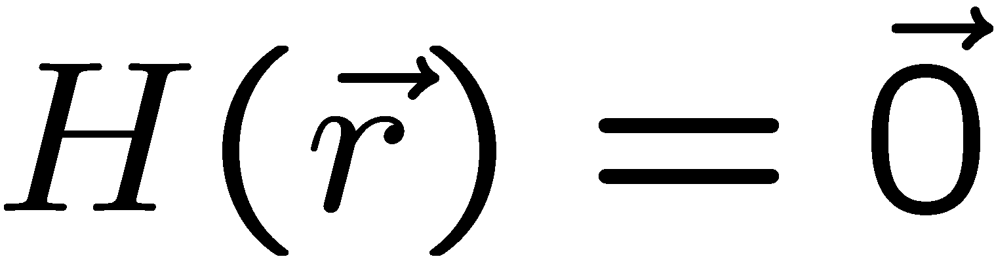
Finding Temporal Reuse
Temporal reuse occurs between iterations and whenever:
Rather than worrying about individual values of and, we say that reuse occurs along direction vector when:
Solution: compute the nullspace of H

Slide 16
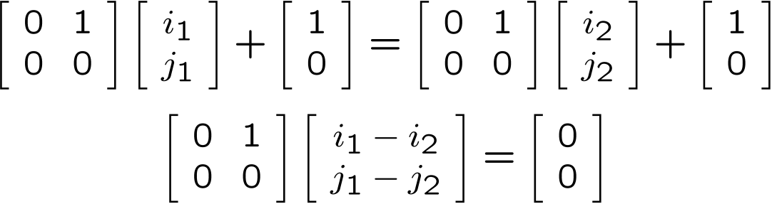
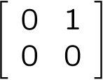
Temporal Reuse Example
for i = 0 to 2
for j = 0 to 100
A[i][j] = B[j][0] + B[j+1][0];
Reuse between iterations (i₁,j₁) and (i₂,j₂) whenever:
True whenever j₁ = j₂, and regardless of the difference between i₁ and i₂.
i.e. whenever the difference lies along the nullspace of ,
which is span{(1,0)} (i.e. the outer loop).

Slide 17
Prefetch Predicate
Locality Type | Miss Instance | Predicate
None | Every Iteration | True
Temporal | First Iteration | i = 0
Spatial | Every l iterations (l = cache line size) | (i mod l) = 0
Example:
for i = 0 to 2
for j = 0 to 100
A[i][j] = B[j][0] + B[j+1][0];
Reference | Locality | Predicate
A[i][j] |  | (j mod 2) = 0
B[j+1][0] |  | i = 0
[
]
[
]
i
j
=
none
spatial
[
]
[
]
i
j
=
temporal
none

Slide 18
Compiler Algorithm
Analysis: what to prefetch
Locality Analysis
Scheduling: when/how to issue prefetches
Loop Splitting
Software Pipelining

Slide 19
Loop Splitting
Decompose loops to isolate cache miss instances
cheaper than inserting IF statements
Apply transformations recursively for nested loops
Suppress transformations when loops become too large
avoid code explosion
Locality Type | Predicate | Loop Transformation
None | True | None
Temporal | i = 0 | Peel loop i
Spatial | (i mod l) = 0 | Unroll loop i by l

Slide 20
Software Pipelining
l
Iterations Ahead = ⎡ ⎤
s
where l = memory latency, s = shortest path through loop body
Original Loop
Software Pipelined Loop
(5 iterations ahead)
for (i = 0; i<100; i++)
a[i] = 0;
for (i = 0; i<5; i++) /* Prolog */
prefetch(&a[i]);
for (i = 0; i<95; i++) { /* Steady State*/
prefetch(&a[i+5]);
a[i] = 0;
}
for (i = 95; i<100; i++) /* Epilog */
a[i] = 0;

Slide 21
Example Revisited
Original Code
Code with Prefetching
for (i = 0; i < 3; i++)
for (j = 0; j < 100; j++)
A[i][j] = B[j][0] + B[j+1][0];
prefetch(&A[0][0]);
for (j = 0; j < 6; j += 2) {
prefetch(&B[j+1][0]);
prefetch(&B[j+2][0]);
prefetch(&A[0][j+1]);
}
for (j = 0; j < 94; j += 2) {
prefetch(&B[j+7][0]);
prefetch(&B[j+8][0]);
prefetch(&A[0][j+7]);
A[0][j] = B[j][0]+B[j+1][0];
A[0][j+1] = B[j+1][0]+B[j+2][0];
}
for (j = 94; j < 100; j += 2) {
A[0][j] = B[j][0]+B[j+1][0];
A[0][j+1] = B[j+1][0]+B[j+2][0];
}
for (i = 1; i < 3; i++) {
prefetch(&A[i][0]);
for (j = 0; j < 6; j += 2)
prefetch(&A[i][j+1]);
for (j = 0; j < 94; j += 2) {
prefetch(&A[i][j+7]);
A[i][j] = B[j][0] + B[j+1][0];
A[i][j+1] = B[j+1][0] + B[j+2][0];
}
for (j = 94; j < 100; j += 2) {
A[i][j] = B[j][0] + B[j+1][0];
A[i][j+1] = B[j+1][0] + B[j+2][0];
}
}
Cache Hit
Cache Miss
i = 0
A[i][j]
i
j
B[j+1][0]
i > 0
i
j

Slide 22
Prefetching Indirections
for (i = 0; i<100; i++)
sum += A[index[i]];
Analysis: what to prefetch
both dense and indirect references
difficult to predict whether indirections hit or miss
Scheduling: when/how to issue prefetches
modification of software pipelining algorithm

Slide 23
Software Pipelining for Indirections
Software Pipelined Loop
(5 iterations ahead)
Original Loop
for (i = 0; i<100; i++)
sum += A[index[i]];
for (i = 0; i<5; i++) /* Prolog 1 */
prefetch(&index[i]);
for (i = 0; i<5; i++) { /* Prolog 2 */
prefetch(&index[i+5]);
prefetch(&A[index[i]]);
}
for (i = 0; i<90; i++) { /* Steady State*/
prefetch(&index[i+10]);
prefetch(&A[index[i+5]]);
sum += A[index[i]];
}
for (i = 90; i<95; i++) { /* Epilog 1 */
prefetch(&A[index[i+5]]);
sum += A[index[i]];
}
for (i = 95; i<100; i++) /* Epilog 2 */
sum += A[index[i]];

Slide 24
Summary of Results
Dense Matrix Code:
eliminated 50% to 90% of memory stall time
overheads remain low due to prefetching selectively
significant improvements in overall performance (6 over 45%)
Indirections, Sparse Matrix Code:
expanded coverage to handle some important cases

Slide 25
Prefetching for Arrays: Concluding Remarks
Demonstrated that software prefetching is effective
selective prefetching to eliminate overhead
dense matrices and indirections / sparse matrices
uniprocessors and multiprocessors
Hardware should focus on providing sufficient memory bandwidth

Slide 26
Prefetching for Recursive Data Structures

Slide 27
Recursive Data Structures
Examples:
linked lists, trees, graphs, ...
A common method of building large data structures
especially in non-numeric programs
Cache miss behavior is a concern because:
large data set with respect to the cache size
temporal locality may be poor
little spatial locality among consecutively-accessed nodes
Goal:
Automatic Compiler-Based Prefetching for Recursive Data Structures

Slide 28
Overview
Challenges in Prefetching Recursive Data Structures
Three Prefetching Algorithms
Experimental Results
Conclusions

Slide 29
Scheduling Prefetches for Recursive Data Structures
Our Goal: fully hide latency
thus achieving fastest possible computation rate of 1/W
e.g., if L = 3W, we must prefetch 3 nodes ahead to achieve this

Slide 30
Performance without Prefetching
computation rate = 1 / (L+W)

Slide 31
Prefetching One Node Ahead
Computation is overlapped with memory accesses
computation rate = 1/L

Slide 32
Prefetching Three Nodes Ahead
computation rate does not improve (still = 1/L)!
Pointer-Chasing Problem:
any scheme which follows the pointer chain is limited to a rate of 1/L

Slide 33
Our Goal: Fully Hide Latency
achieves the fastest possible computation rate of 1/W

Slide 34
Overview
Challenges in Prefetching Recursive Data Structures
Three Prefetching Algorithms
Greedy Prefetching
History-Pointer Prefetching
Data-Linearization Prefetching
Experimental Results
Conclusions

Slide 35
Pointer-Chasing Problem
Key:
n_{i} needs to know &n_{i+d} without referencing the d-1 intermediate nodes
Our proposals:
use existing pointer(s) in n_{i} to approximate &n_{i+d}
Greedy Prefetching
add new pointer(s) to n_{i} to approximate &n_{i+d}
History-Pointer Prefetching
compute &n_{i+d} directly from &n_{i} (no ptr deref)
History-Pointer Prefetching

Slide 36
Greedy Prefetching
Prefetch all neighboring nodes (simplified definition)
only one will be followed by the immediate control flow
hopefully, we will visit other neighbors later
Reasonably effective in practice
However, little control over the prefetching distance
preorder(treeNode * t){
if (t != NULL){
pf(t->left);
pf(t->right);
process(t->data);
preorder(t->left);
preorder(t->right);
}
}

Slide 37
History-Pointer Prefetching
Add new pointer(s) to each node
history-pointers are obtained from some recent traversal
Trade space & time for better control over prefetching distances

Slide 38
Data-Linearization Prefetching
No pointer dereferences are required
Map nodes close in the traversal to contiguous memory

Slide 39
Summary of Prefetching Algorithms
 | Greedy | History-Pointer | Data-Linearization
Control over Prefetching Distance | little | more precise | more precise
Applicability to Recursive Data Structures | any RDS | revisited; changes only slowly | must have a major traversal order; changes only slowly
Overhead in Preparing Prefetch Addresses | none | space + time | none in practice
Ease of Implementation | relatively straightforward | more difficult | more difficulty

Slide 40
Conclusions
Propose 3 schemes to overcome the pointer-chasing problem:
Greedy Prefetching
History-Pointer Prefetching
Data-Linearization Prefetching
Automated greedy prefetching in SUIF
improves performance significantly for half of Olden
memory feedback can further reduce prefetch overhead
The other 2 schemes can outperform greedy in some situations

Slide 41
CSC D70: Compiler Optimization Prefetching
Prof. Gennady Pekhimenko
University of Toronto
Winter 2021
The content of this lecture is adapted from the lectures of
Todd Mowry and Phillip Gibbons

